Slide 1
University of Basrah
College of Medicine
Department of Pathology and Forensic Medicine
Practical ONE
Cellular Necrosis

Slide 2
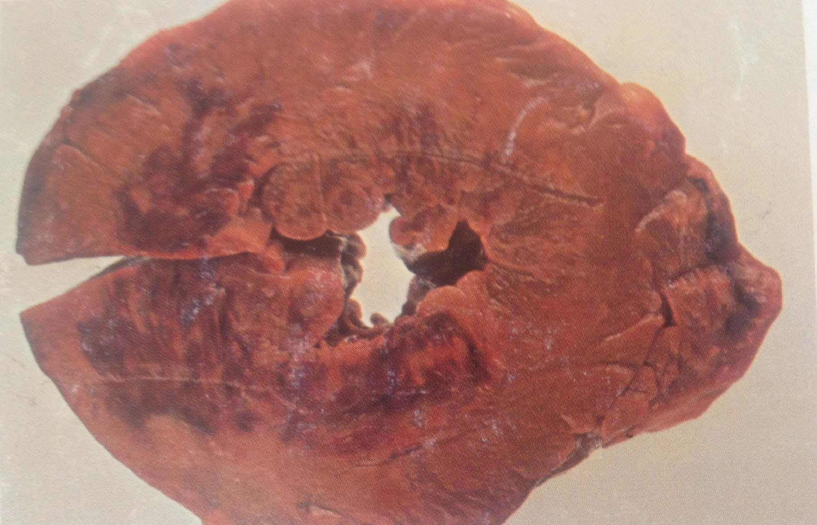
Infarction of Myocardium

Slide 3
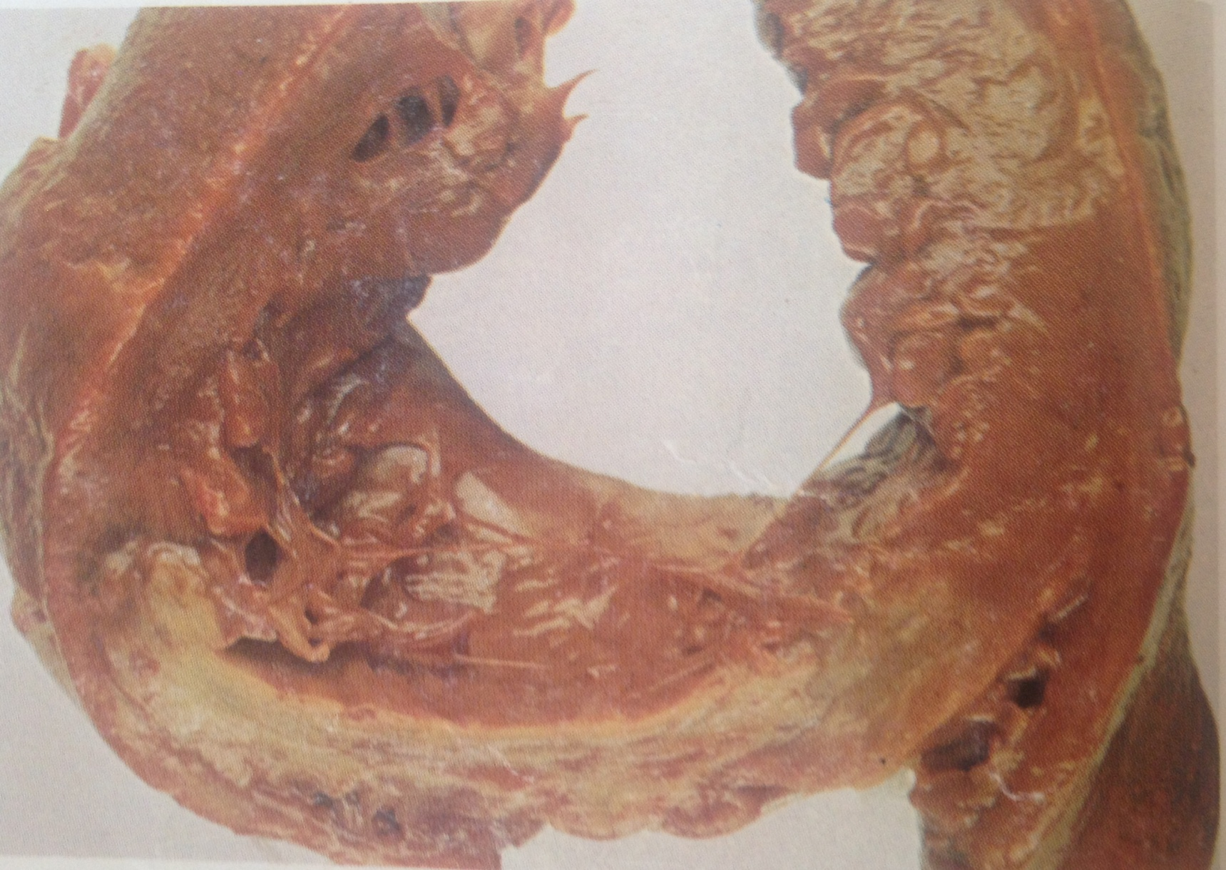
Infarction of Myocardium

Slide 4
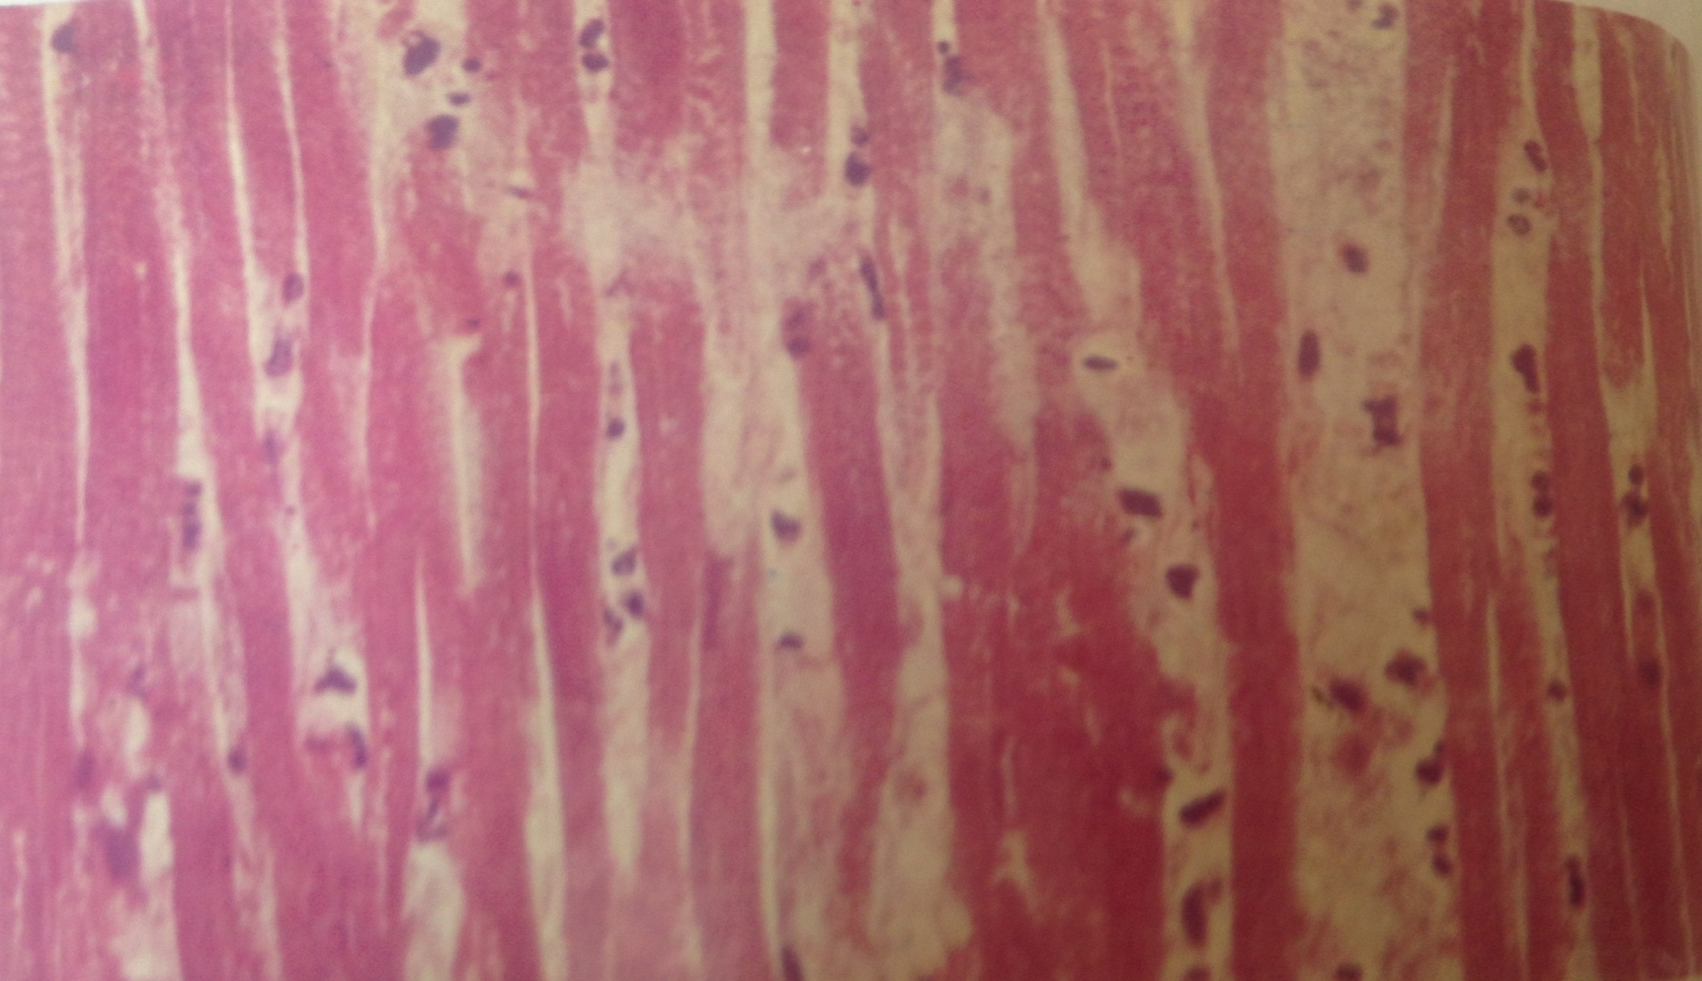
Infarction of Myocardium

Slide 5
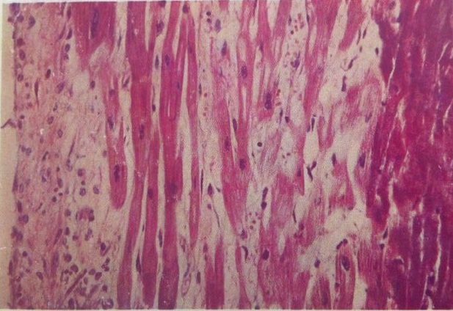
Infarction of Myocardium

Slide 6
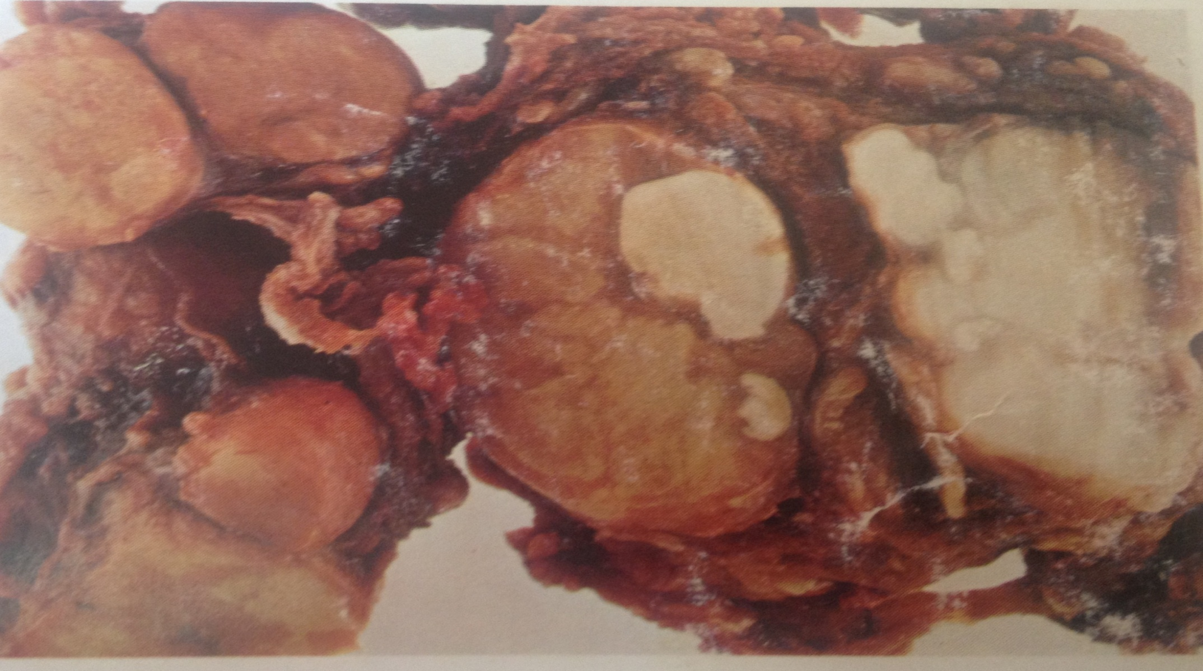
Caseous Necrosis: lymph node

Slide 7
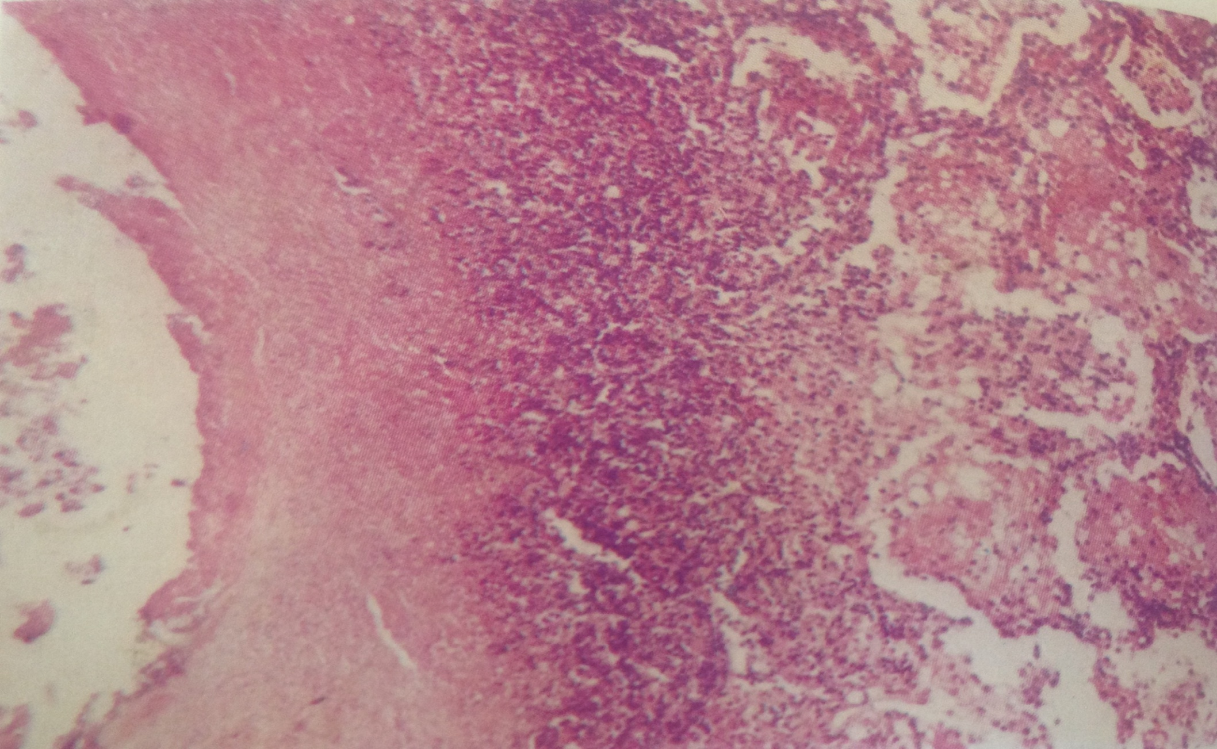
Tuberculous Pneumonia

Slide 8
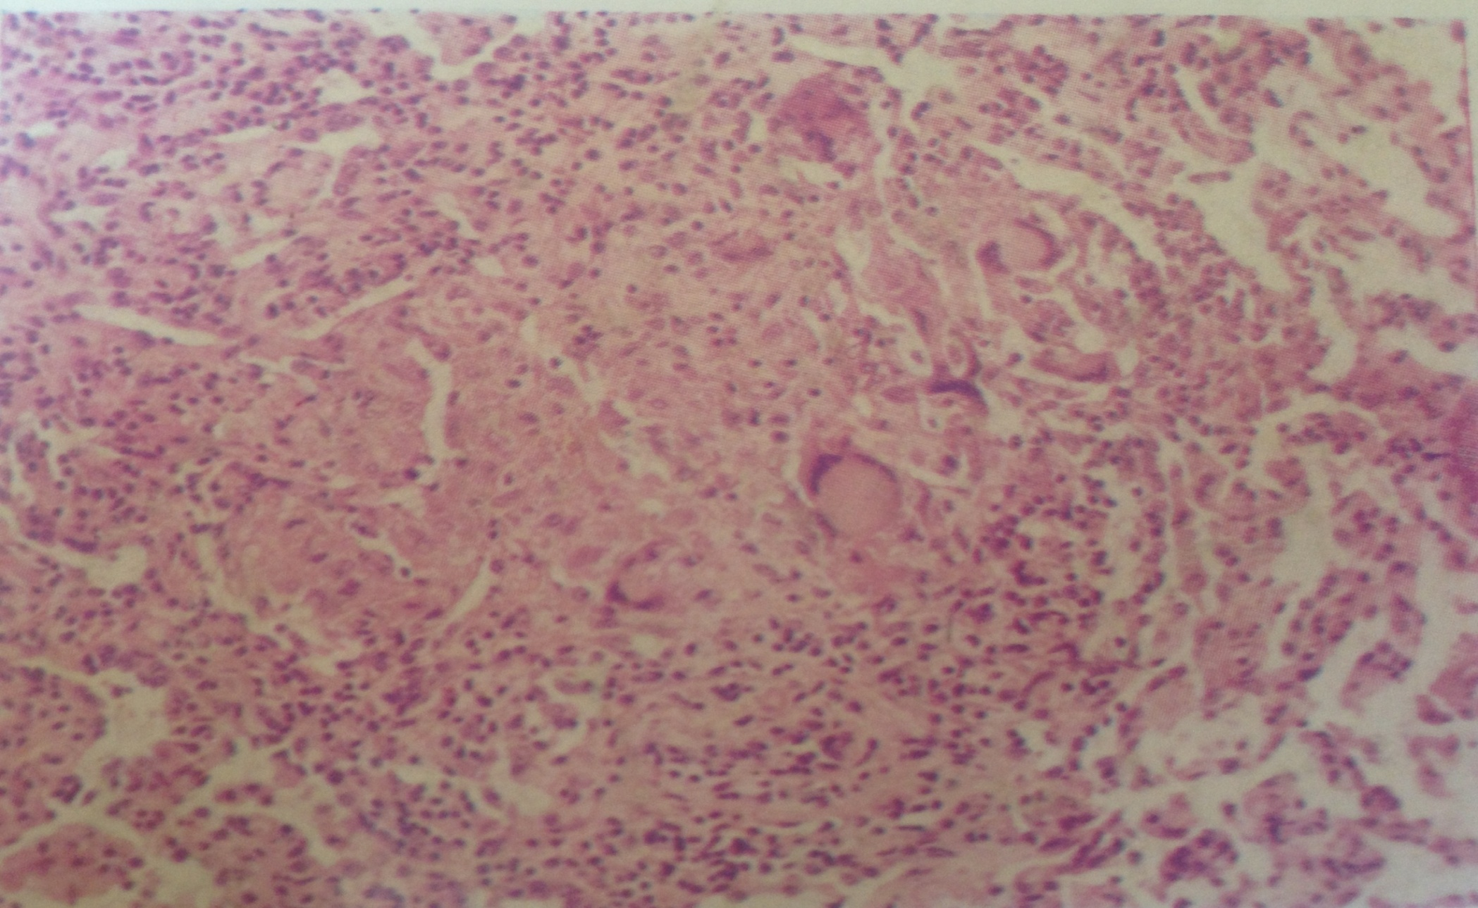
Acute miliary tuberculosis

Slide 9
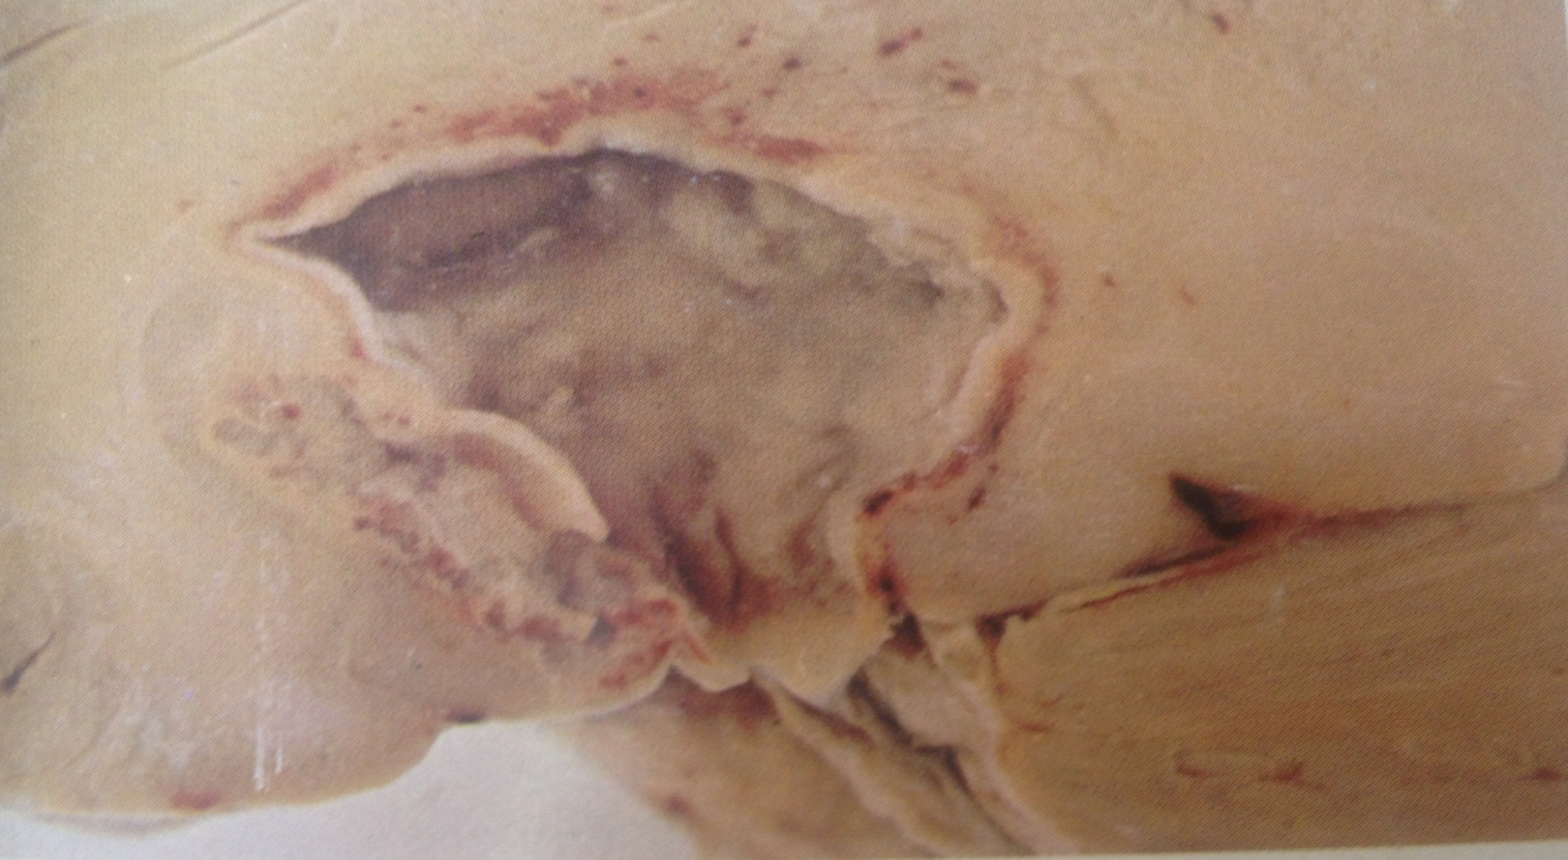
Brain abscess
( Liquifactive Necrosis)

